Slide 1
Machine Learning
Data Engineering Notes

Slide 2
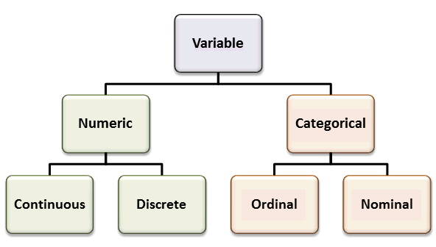
Variable Types
Quantitative (Numerical) Variables:
  Discrete: usually counts of individual items (e.g., age, number of students, etc.).
  Continuous: any value within a range, which often represent measurements (e.g., weight of a person, temperature, etc.).
Categorical (Qualitative) Variables:
  Ordinal: categories that can be ordered (e.g., size of clothes, size of products, etc.).
  Nominal: two or more categories with no specified order (e.g., product types, type of weather, etc.,)
Each variable can furthered be categorized as:
  Independent (Inputs): a variable that is observed within an experiment/environment.
  Dependent (Targets): a variable that depends on one or multiple independent variables.
  For example: the temperature (dependent) can be predicted by measuring altitude, latitude, continentality, air mass circulation, vegetation density, or other geographical factors (independent).

Slide 3
Categorical Variables Encoding
Statistical and Tree-based algorithms can easily work with categorical variables.
However, algorithms such as KNN, Linear/Logistic regression, SVMs and NNs work only with numeric values.
  The categorical values must be encoded (converted) into numerical ones.
Popular Encoding Methods:
  Ordinal Encoding
  One-Hot Encoding
  Frequency Encoding
  Target Encoding

Slide 4
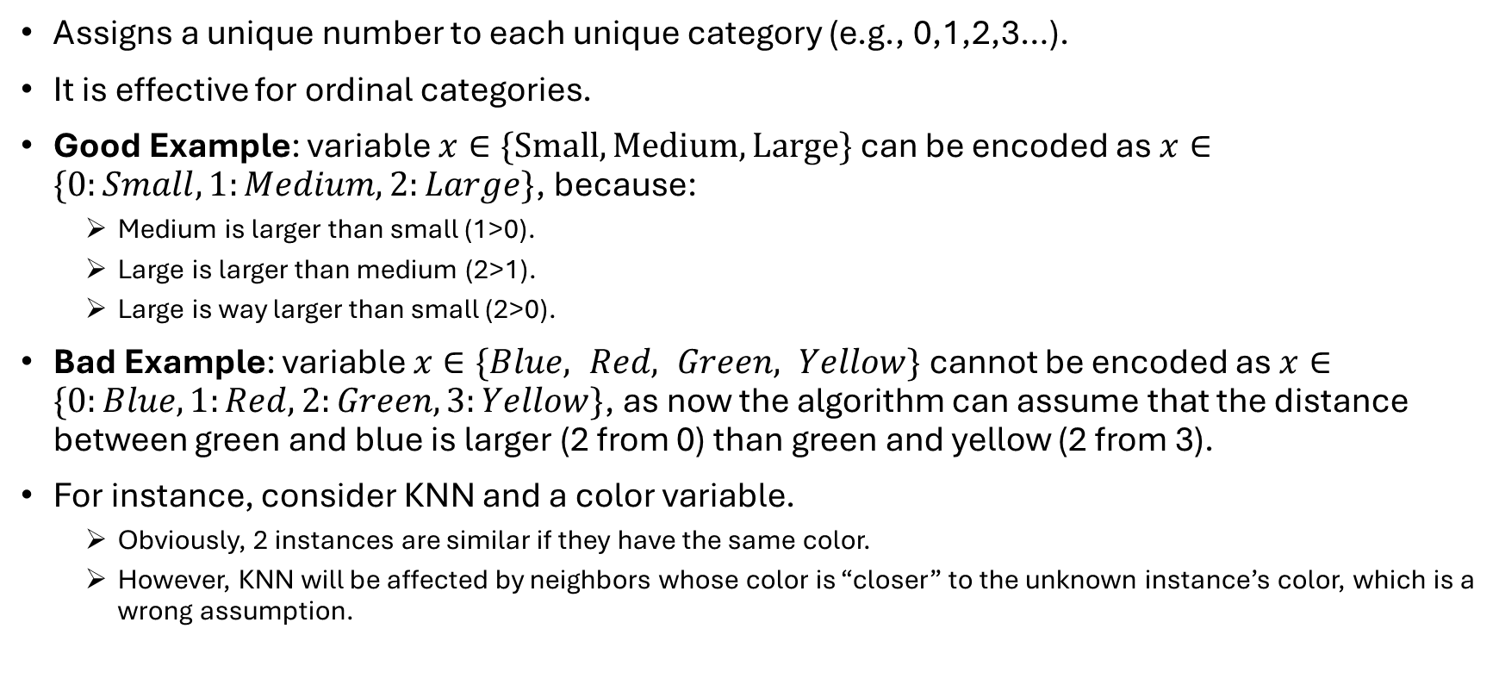
Ordinal Encoding
Assigns a unique number to each unique category (e.g., 0,1,2,3…).
It is effective for ordinal categories.
Good Example: variable $x∈\{Small, Medium, Large\}$ can be encoded as $x∈\{0:Small,1:Medium,2:Large\}$, because:
  Medium is larger than small (1>0).
  Large is larger than medium (2>1).
  Large is way larger than small (2>0).
Bad Example: variable $x∈\{Blue, Red, Green, Yellow\}$ cannot be encoded as $x∈\{0:Blue,1:Red,2:Green,3:Yellow\}$, as now the algorithm can assume that the distance between green and blue is larger (2 from 0) than green and yellow (2 from 3).
For instance, consider KNN and a color variable.
  Obviously, 2 instances are similar if they have the same color.
  However, KNN will be affected by neighbors whose color is “closer” to the unknown instance’s color, which is a wrong assumption.

Slide 5
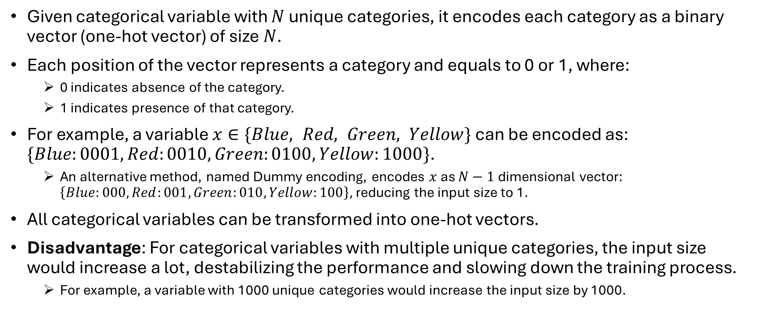
One-Hot Encoding
Given categorical variable with $N$ unique categories, it encodes each category as a binary vector (one-hot vector) of size $N$.
Each position of the vector represents a category and equals to 0 or 1, where:
  0 indicates absence of the category.
  1 indicates presence of that category.
For example, a variable $x∈\{Blue, Red, Green, Yellow\}$ can be encoded as: $\{Blue:0001, Red:0010, Green:0100, Yellow:1000\}$.
  An alternative method, named Dummy encoding, encodes $x$ as $N−1$ dimensional vector: $\left\{Blue:000, Red:001, Green:010, Yellow:100\right\},$reducing the input size to 1.
All categorical variables can be transformed into one-hot vectors.
Disadvantage: For categorical variables with multiple unique categories, the input size would increase a lot, destabilizing the performance and slowing down the training process.
  For example, a variable with 1000 unique categories would increase the input size by 1000.

Slide 6
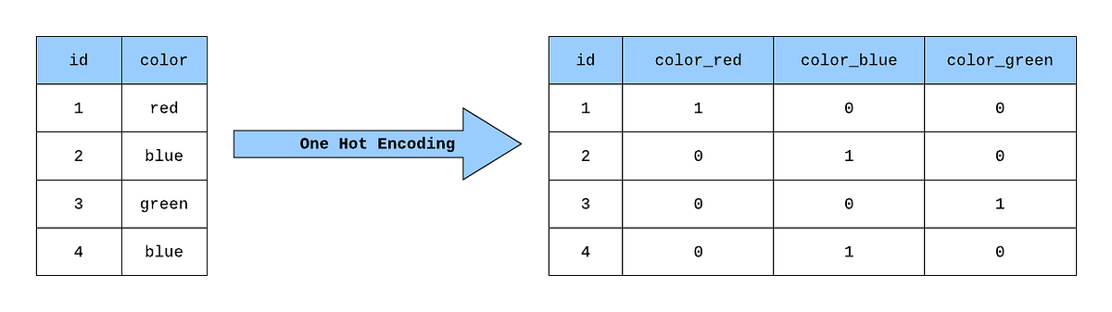
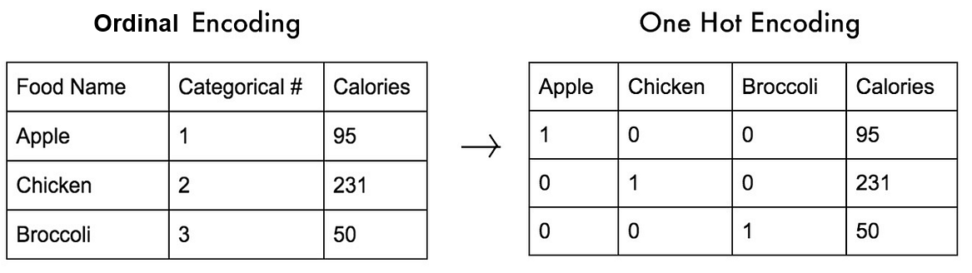
Ordinal vs One-Hot Encoding

Slide 7
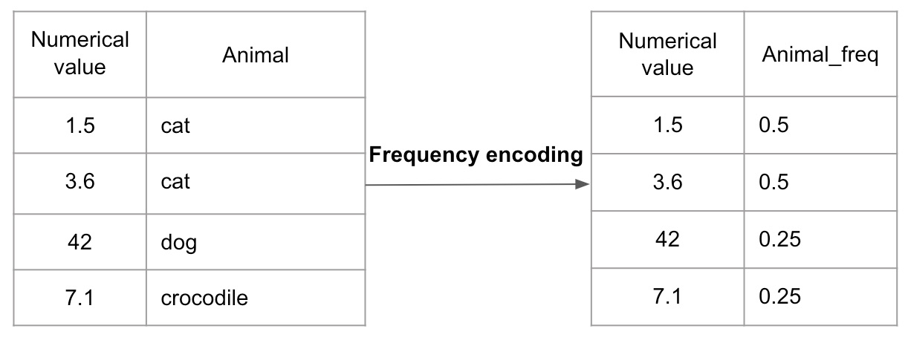
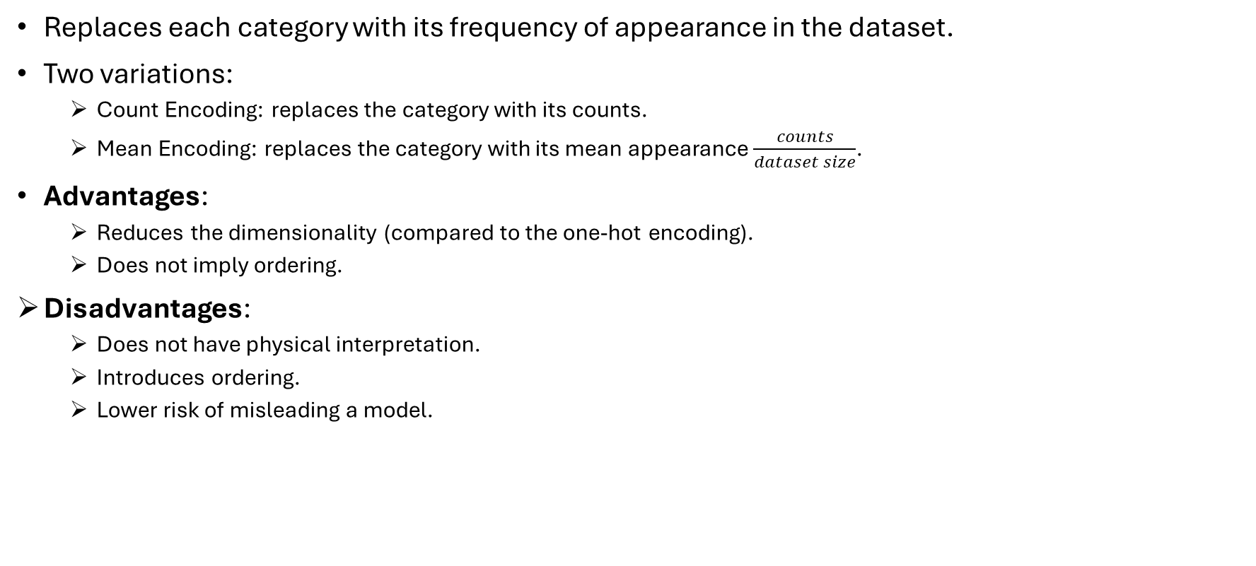
Frequency Encoding
Replaces each category with its frequency of appearance in the dataset.
Two variations:
  Count Encoding: replaces the category with its counts.
  Mean Encoding: replaces the category with its mean appearance $\frac{counts}{dataset size}$.
Advantages:
  Reduces the dimensionality (compared to the one-hot encoding).
  Does not imply ordering.
Disadvantages:
  Does not have physical interpretation.
  Introduces ordering.
  Lower risk of misleading a model.

Slide 8
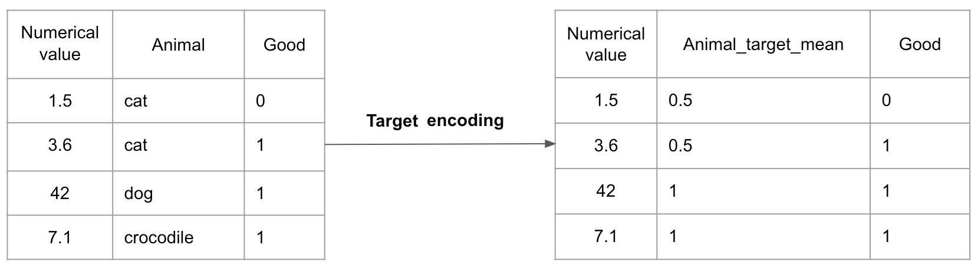
Target Encoding
Similar to the frequency encoding, but it uses the target frequency instead.
In this example, Animal is the categorical variable and Good is the target.
Animal equals “cat” 1 time when target is 0 and 1 time when target is 1. So its target frequency is 0.5 (1/2).
On the other hand, Animal equals “dog” when target is 1, so its target frequency is 1. Same with the crocodile.

Slide 9
Other Data Types (IDs, Dates, Locations)
IDs: usually, are irrelevant to the training process and are omitted (dropped) from the dataset.
Dates: can be observed in time-dependent variables (such as timeseries). Although date is irrelevant to the training process, several features can be extracted, such as:
  Time Features (seconds, minutes, hours, etc.).
  Daily Features (day, week, month, year, etc.).
  Events (holidays, wars, crisis events, etc.).
Locations: can be encoded as one-hot vectors or as pairs of (longitude, latitude) if the geographical location is important.
  Example 1: to examine the income of the population, we can one-hot each city.
  Example 2: to predict the temperature, we can encode the location as a vector of (longitude, latitude), which can provide us information about its continentality (how far a place is located from water, which affects its climate).

Slide 10
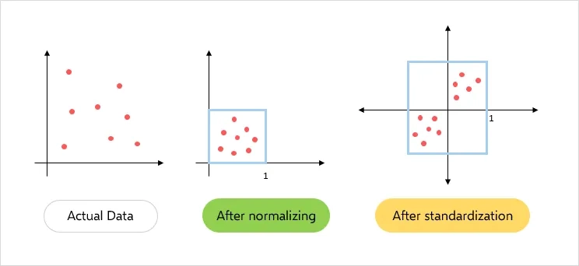
Data Normalization
The performance of ML algorithms depends on:
  The different scales between the variables (e.g., the value range affect the distance metric in KNN).
  The distribution of the variables (e.g., linear regression assumes the variables follow normal distribution).
Παραδείγματα μη-κανονικοποιημένων δεδομένων:
  Ο KNN εκμεταλλεύεται μεταβλητές με μεγάλο εύρος για να βρει κοντινούς γείτονες, αγνοώντας τις υπόλοιπες μεταβλητές.
  Η γραμμική παλινδρόμηση δυσκολεύεται να προβλέψει μεταβλητή που έχει μεγάλο εύρος τιμών, σε σχέση με μεταβλητή φραγμένη στο [0, 1],
Normalization methods attempt to correct these issues, improve model performance and provide numerical stability. These methods include:
  MinMax
  MaxAbs
  Standard
  Robust
  Log Returns (for Timeseries Forecasting)

Slide 11
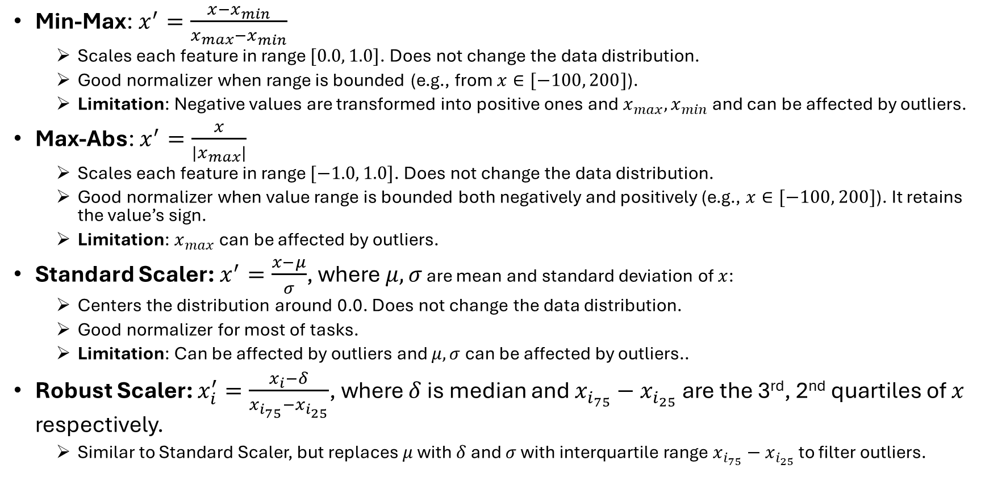
Data Normalization Methods
Min-Max: $x^{′}=\frac{x−x_{min}}{x_{max}−x_{min}}$
  Scales each feature in range $[0.0, 1.0]$. Does not change the data distribution.
  Good normalizer when range is bounded (e.g., from $x∈[−100, 200]$).
  Limitation: Negative values are transformed into positive ones and $x_{max},x_{min}$ and can be affected by outliers.
Max-Abs: $x^{′}=\frac{x}{|x_{max}|}$
  Scales each feature in range $[−1.0, 1.0]$. Does not change the data distribution.
  Good normalizer when value range is bounded both negatively and positively (e.g., $x∈[−100, 200]$). It retains the value’s sign.
  Limitation: $x_{max}$can be affected by outliers.
Standard Scaler: $x^{′}=\frac{x−μ}{σ}$, where $μ,σ$ are mean and standard deviation of $x$:
  Centers the distribution around 0.0. Does not change the data distribution.
  Good normalizer for most of tasks.
  Limitation: Can be affected by outliers and $μ,σ$ can be affected by outliers..
Robust Scaler: $x_{i}^{′}=\frac{x_{i}−δ}{x_{i_{75}}−x_{i_{25}}}$, where $δ$ is median and $x_{i_{75}}−x_{i_{25}}$ are the 3rd, 2nd quartiles of $x$ respectively.
  Similar to Standard Scaler, but replaces $μ$ with $δ$ and $σ$ with interquartile range $x_{i_{75}}−x_{i_{25}}$ to filter outliers.

Slide 12
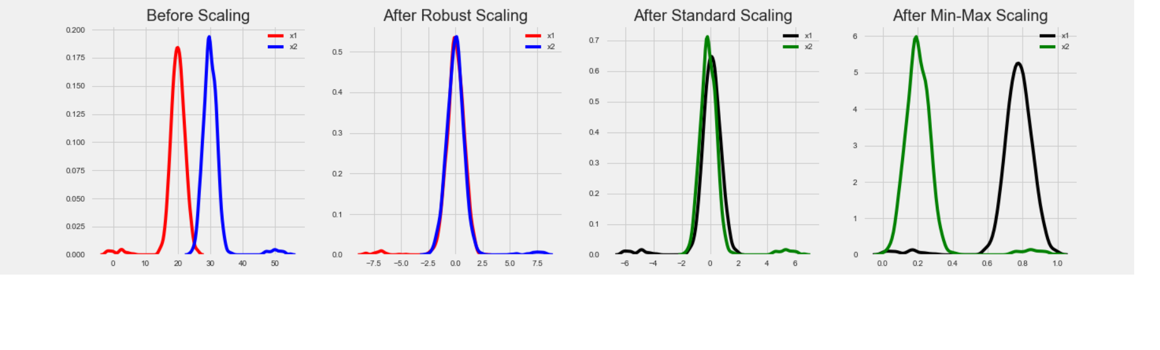
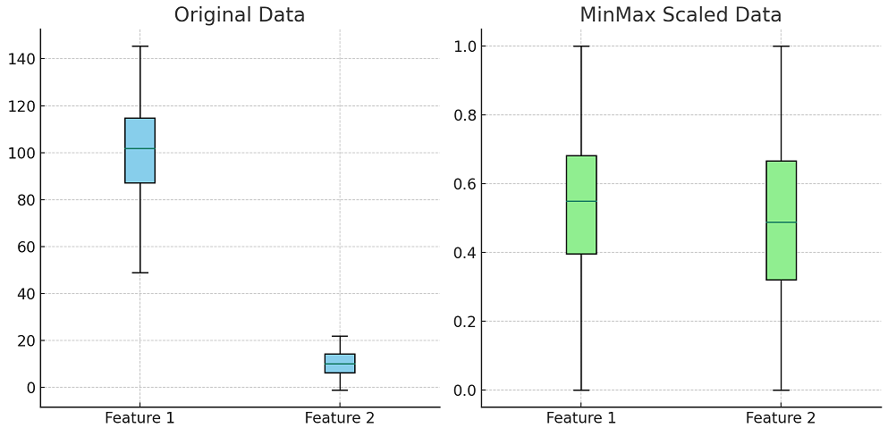
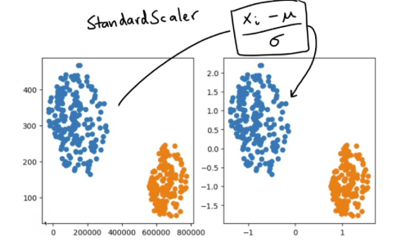
Data Normalization Methods Comparison

Slide 13
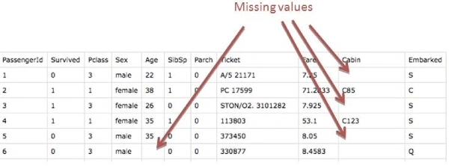
Missing Values
Methods that work well with categorical variables (e.g., trees), can handle missing values (depending on the implementation).
Other ML methods require only numerical values (e.g., Linear/Logistic Regression, KNN, etc.).
A simple approach is to drop all instances (rows) that include missing values.
  Limitation: If the dataset small (low number of instances), we might not afford to drop these instances.
  For example, in dataset with 1000 total instances, 400 of them include missing values. If we drop them, we lose 40% of the collected data.
Another approach is the use of imputation methods, which fill the missing values.

Slide 14
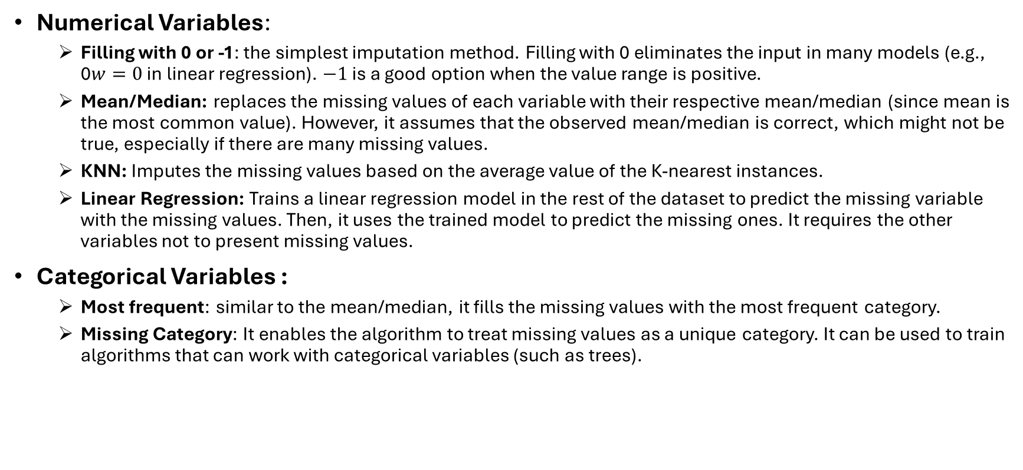
Imputation Methods
Numerical Variables:
  Filling with 0 or -1: the simplest imputation method. Filling with 0 eliminates the input in many models (e.g., 0$w=0$ in linear regression). $−1$ is a good option when the value range is positive.
  Mean/Median: replaces the missing values of each variable with their respective mean/median (since mean is the most common value). However, it assumes that the observed mean/median is correct, which might not be true, especially if there are many missing values.
  KNN: Imputes the missing values based on the average value of the K-nearest instances.
  Linear Regression: Trains a linear regression model in the rest of the dataset to predict the missing variable with the missing values. Then, it uses the trained model to predict the missing ones. It requires the other variables not to present missing values.
Categorical Variables :
  Most frequent: similar to the mean/median, it fills the missing values with the most frequent category.
  Missing Category: It enables the algorithm to treat missing values as a unique category. It can be used to train algorithms that can work with categorical variables (such as trees).

Slide 15
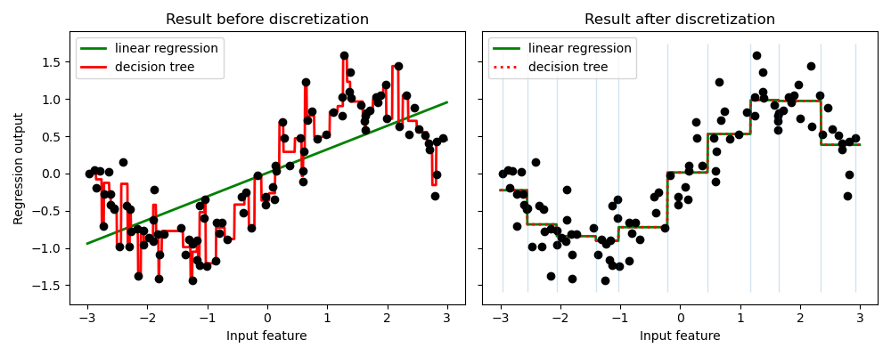
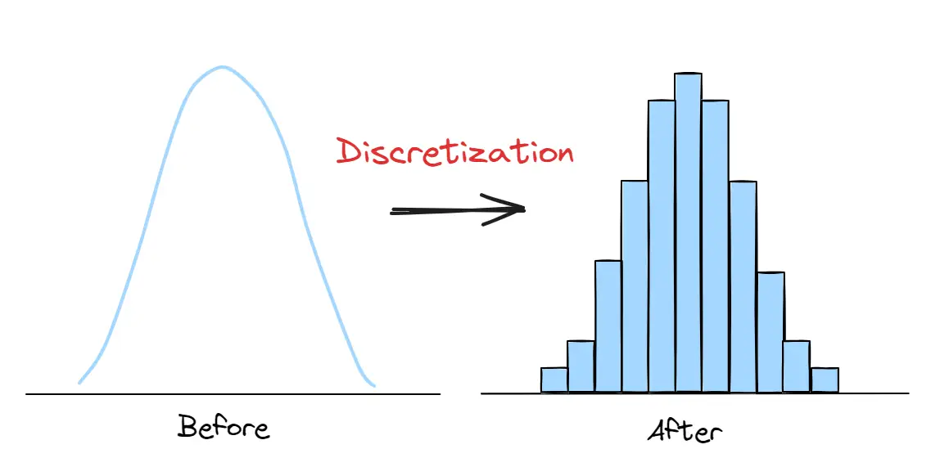
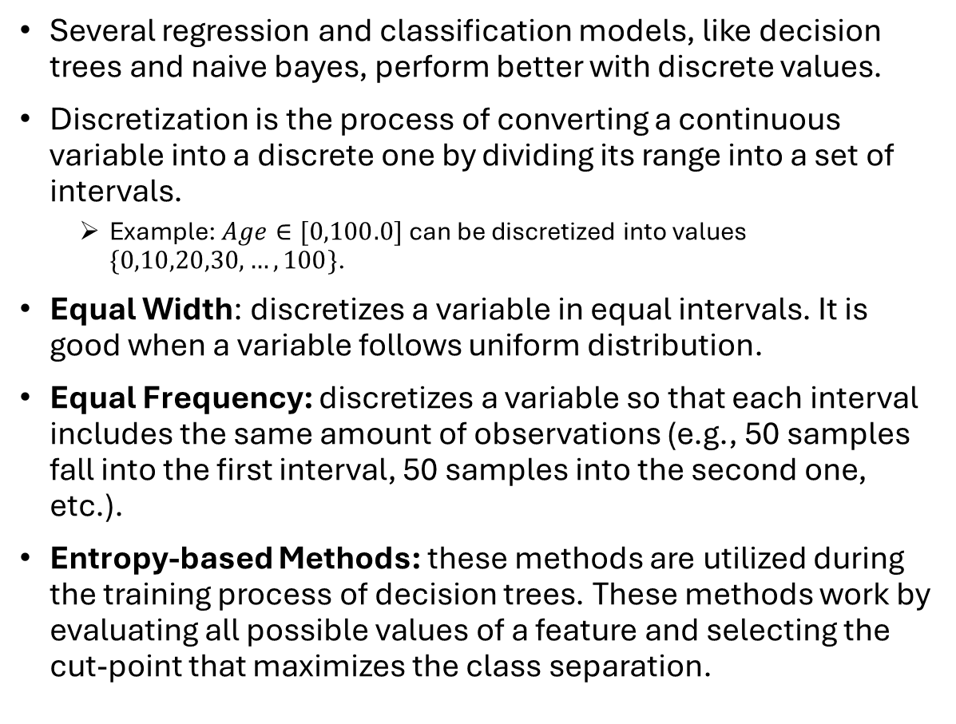
Discretization
Several regression and classification models, like decision trees and naive bayes, perform better with discrete values.
Discretization is the process of converting a continuous variable into a discrete one by dividing its range into a set of intervals.
  Example: $Age∈[0,100.0]$ can be discretized into values $\{0,10,20,30,…,100\}$.
Equal Width: discretizes a variable in equal intervals. It is good when a variable follows uniform distribution.
Equal Frequency: discretizes a variable so that each interval includes the same amount of observations (e.g., 50 samples fall into the first interval, 50 samples into the second one, etc.).
Entropy-based Methods: these methods are utilized during the training process of decision trees. These methods work by evaluating all possible values of a feature and selecting the cut-point that maximizes the class separation.

Slide 16
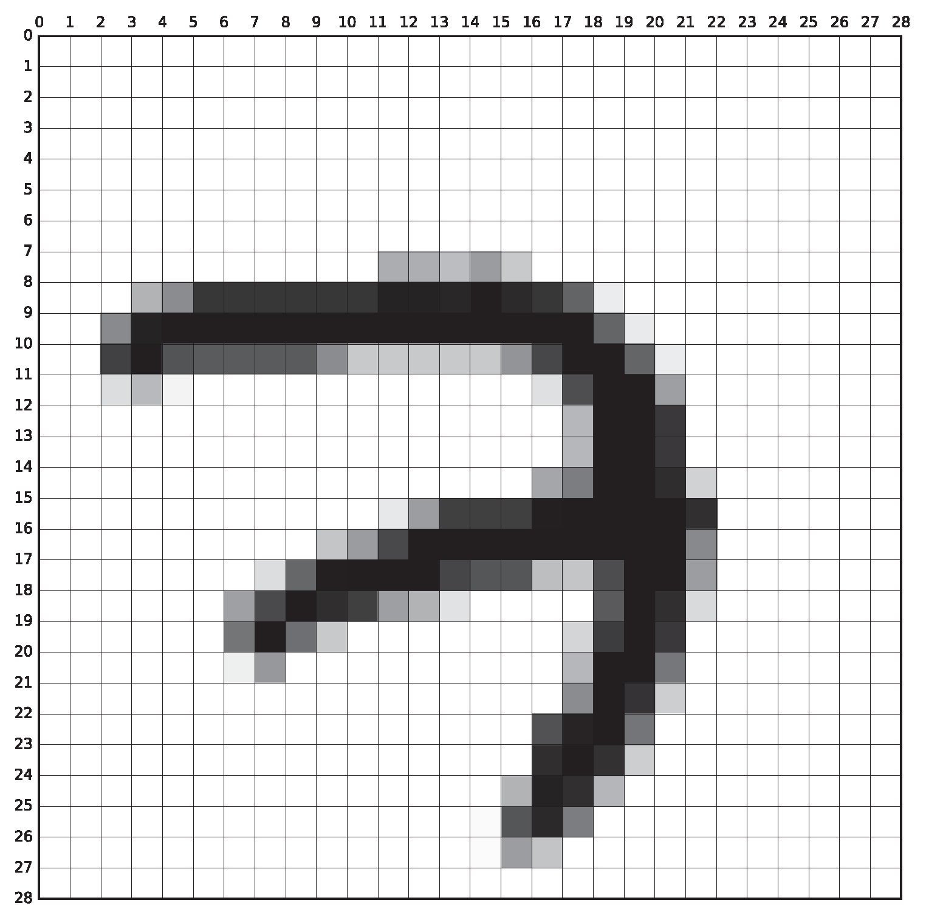
Feature Selection
It is possible that some features are irrelevant for a supervised learning tasks. Such features act as “noise” and reduce performance.
  Example 1: predicting the outcome of a soccer match based on the time.
  Example 2: classifying a digit from an image, with only a few pixels showing the digit.
Other variables might present significant correlations, reducing the explainability/interpretability potential of the algorithm.
Feature selection is the process of eliminating unnecessary features from the dataset, without losing performance.
Brute-Force: Eliminates the worst-performing features by trying all the possible combinations. It is impossible for large datasets, due to time restrictions.
Low Variance Features: this approach eliminates features with low variance (as they contain little to no information).
Regularization Methods: these methods enable the algorithm to eliminate unnecessary features during training (e.g., l1-penalty (lasso) in Linear regression).
NOISE
NOISE
NOISE
NOISE

Slide 17
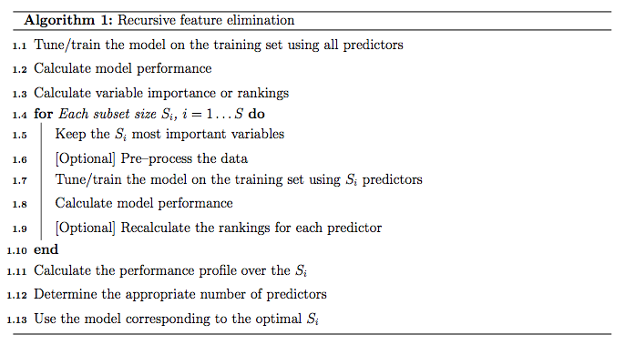
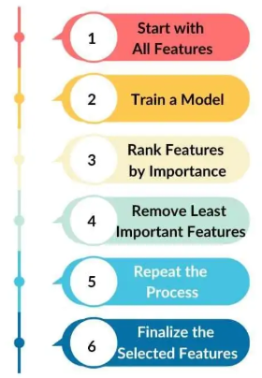
Recursive Feature Elimination (RFE)
It does not guarantee to find the optimal set of variables, only an approximation!
Another variation of this algorithm trains a model using a single variable and incrementally adds the rest of the variables, based on the model’s performance.

Slide 18
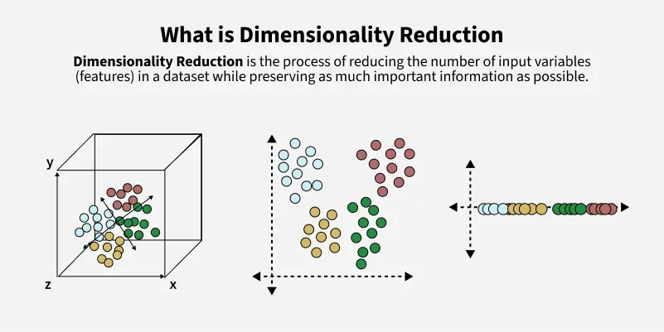
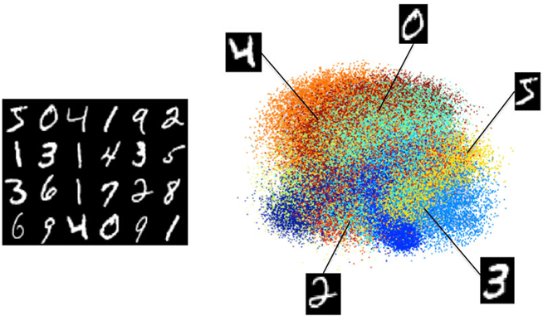
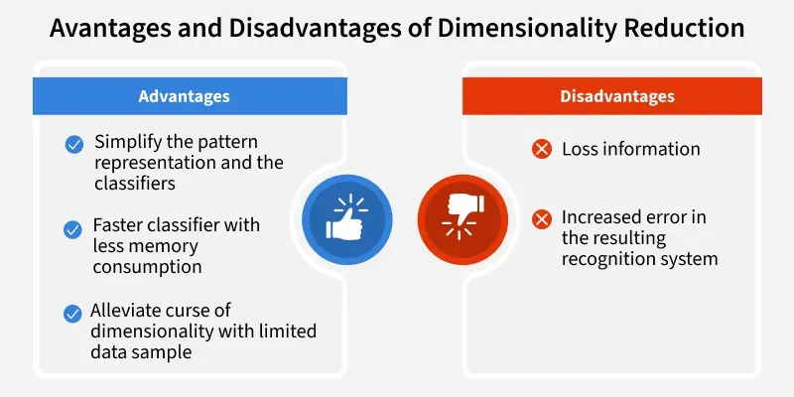
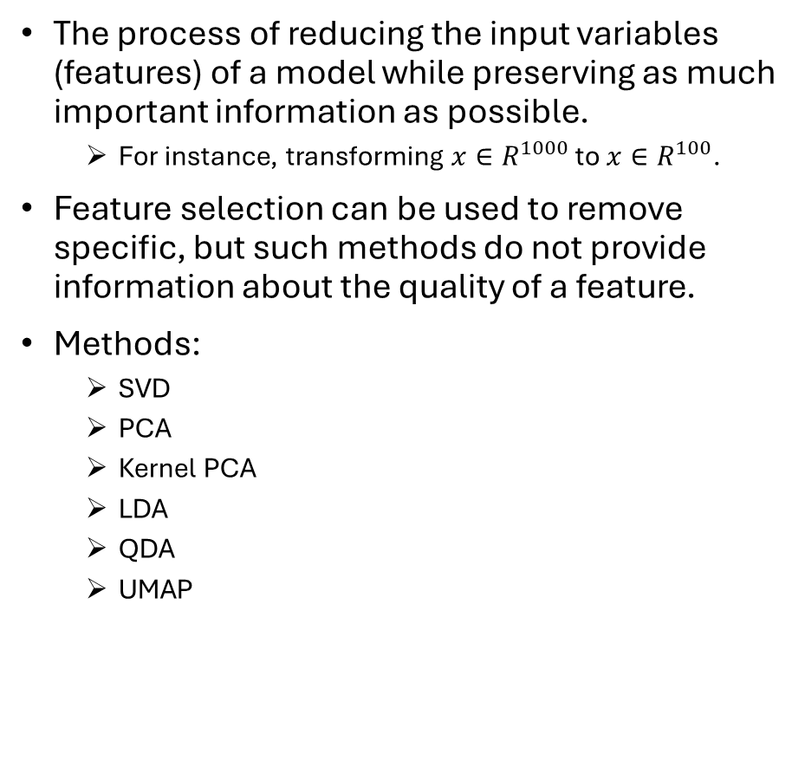
Dimensionality Reduction
The process of reducing the input variables (features) of a model while preserving as much important information as possible.
  For instance, transforming $x∈R^{1000}$ to $x∈R^{100}$.
Feature selection can be used to remove specific, but such methods do not provide information about the quality of a feature.
Methods:
  SVD
  PCA
  Kernel PCA
  LDA
  QDA
  UMAP

Slide 19
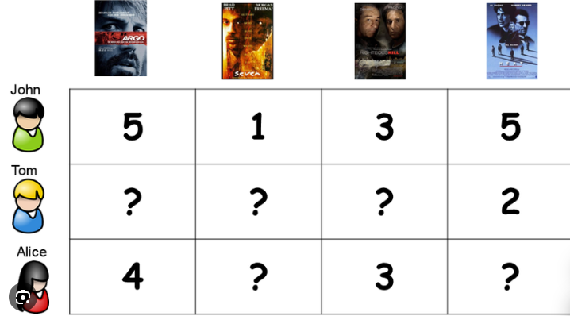
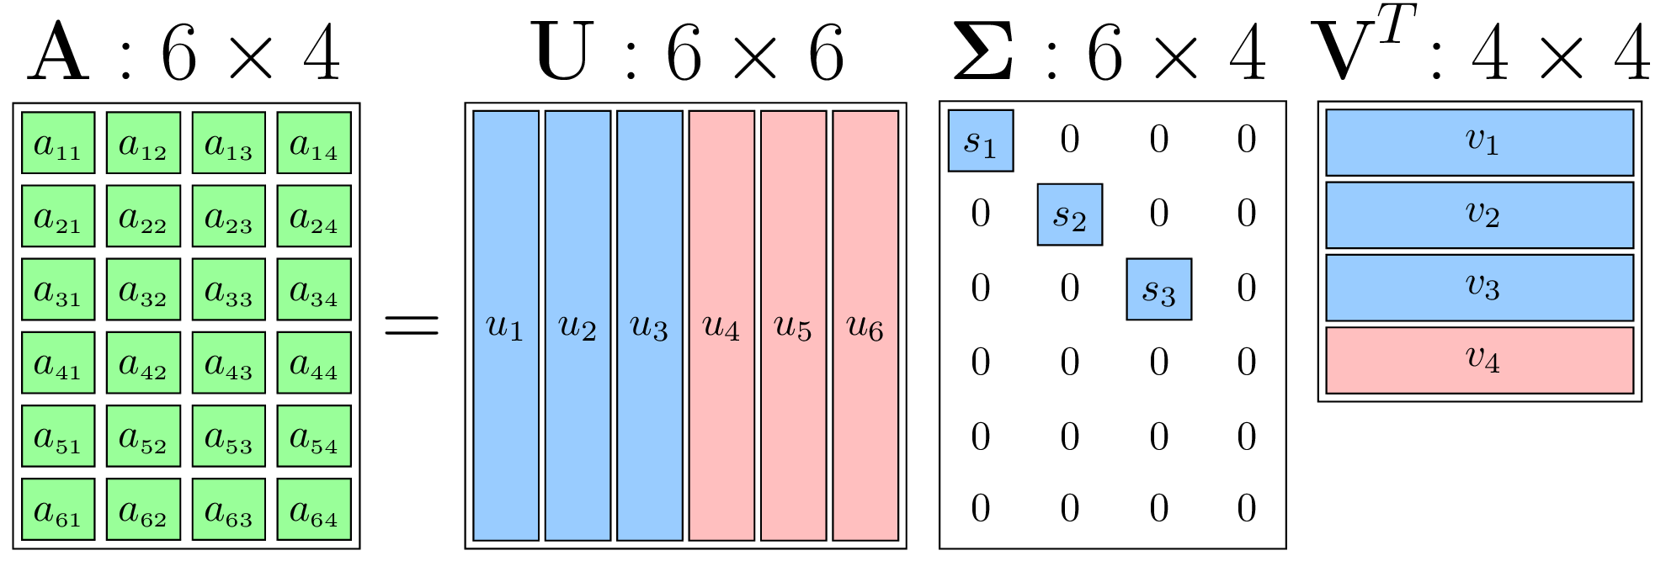
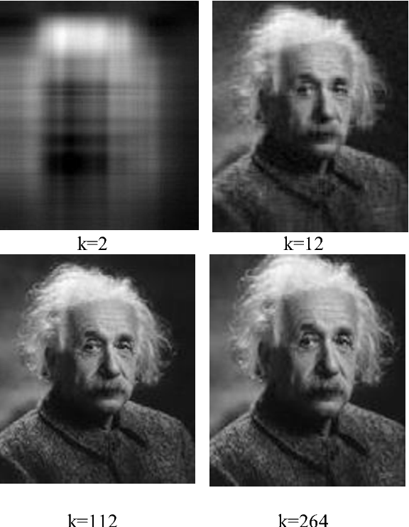
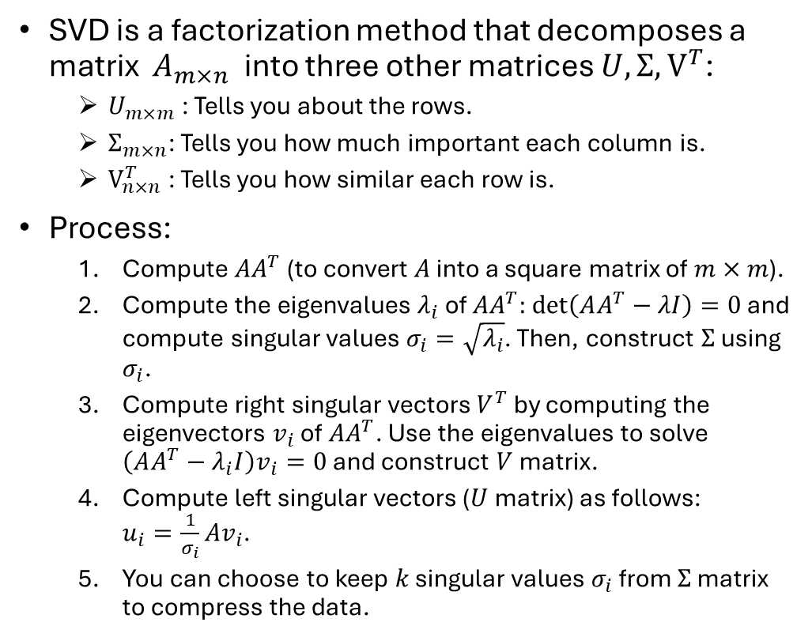


Singular Value Decomposition (SVD)
$$n$$
SVD is a factorization method that decomposes a matrix $A_{m×n}$ into three other matrices $U,Σ,V^{T}$:
  $U_{m×m}$: Tells you about the rows.
  $Σ_{m×n}$: Tells you how much important each column is.
  $V_{n×n}^{T}$: Tells you how similar each row is.
Process:
  Compute $AA^{T}$ (to convert $A$ into a square matrix of $m×m$).
  Compute the eigenvalues $λ_{i}$ of $AA^{T}:$ $\det\left(AA^{T}−λI\right)=0$ and compute singular values $σ_{i}=\sqrt{λ_{i}}$. Then, construct $Σ$ using $σ_{i}$.
  Compute right singular vectors $V^{T}$ by computing the eigenvectors $v_{i}$ of $AA^{T}$. Use the eigenvalues to solve $\left(AA^{T}−λ_{i}I\right)v_{i}=0$ and construct $V$ matrix.
  Compute left singular vectors ($U$ matrix) as follows:
  $u_{i}=\frac{1}{σ_{i}}{Av}_{i}$.
  You can choose to keep $k$ singular values $σ_{i}$ from $Σ$ matrix to compress the data.
$$m$$

Slide 20
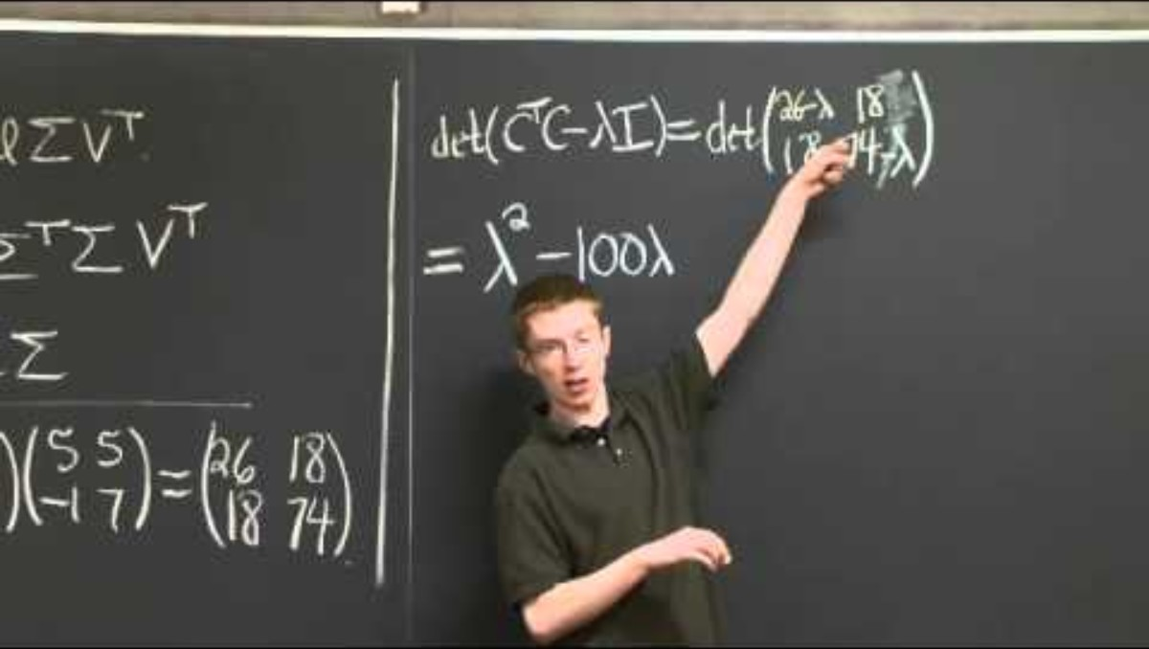
SVD Example

Slide 21


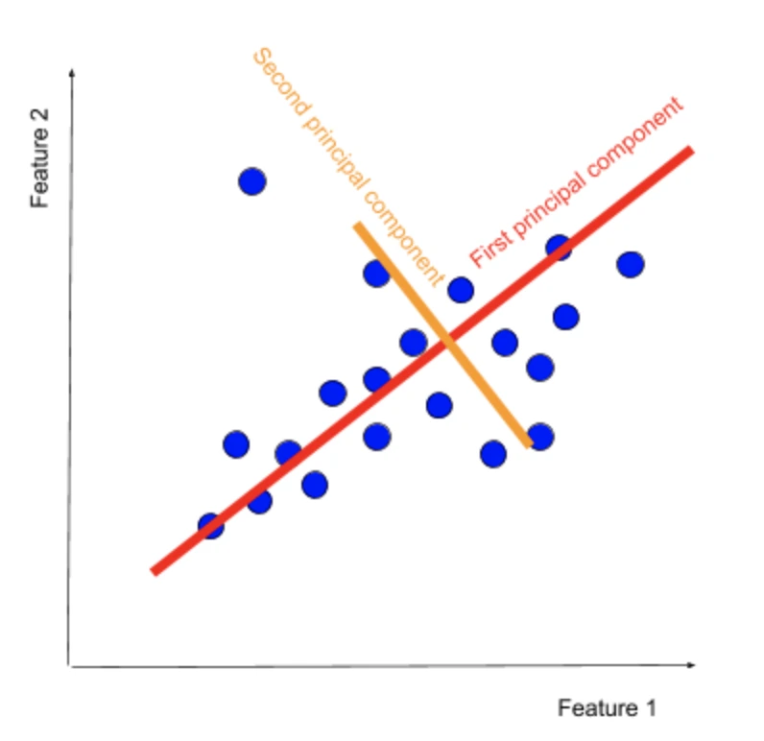
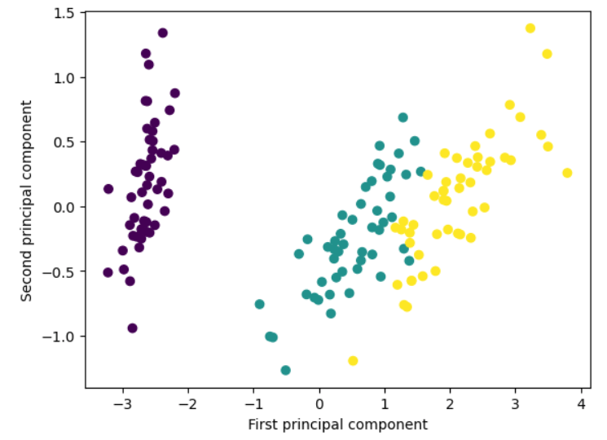
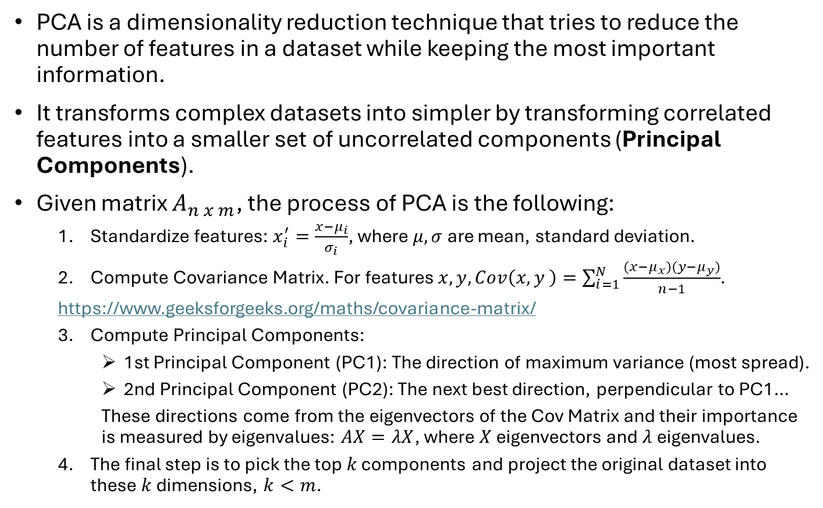
Principal Component Analysis (PCA)
Cov
Matrix
PCA is a dimensionality reduction technique that tries to reduce the number of features in a dataset while keeping the most important information.
It transforms complex datasets into simpler by transforming correlated features into a smaller set of uncorrelated components (Principal Components).
Given matrix $A_{n x m}$, the process of PCA is the following:
  Standardize features: $x_{i}^{′}=\frac{x−μ_{i}}{σ_{i}}$, where $μ,σ$ are mean, standard deviation.
  Compute Covariance Matrix. For features $x,y, Cov\left(x,y \right)=\sum_{i=1}^{N}{\frac{(x−μ_{x})(y−μ_{y})}{n−1}}$.
  https://www.geeksforgeeks.org/maths/covariance-matrix/
  Compute Principal Components:
    1st Principal Component (PC1): The direction of maximum variance (most spread).
    2nd Principal Component (PC2): The next best direction, perpendicular to PC1…
    These directions come from the eigenvectors of the Cov Matrix and their importance is measured by eigenvalues: $AX=λX$, where $X$ eigenvectors and $λ$ eigenvalues.
  The final step is to pick the top $k$ components and project the original dataset into these $k$ dimensions, $k<m$.

Slide 22
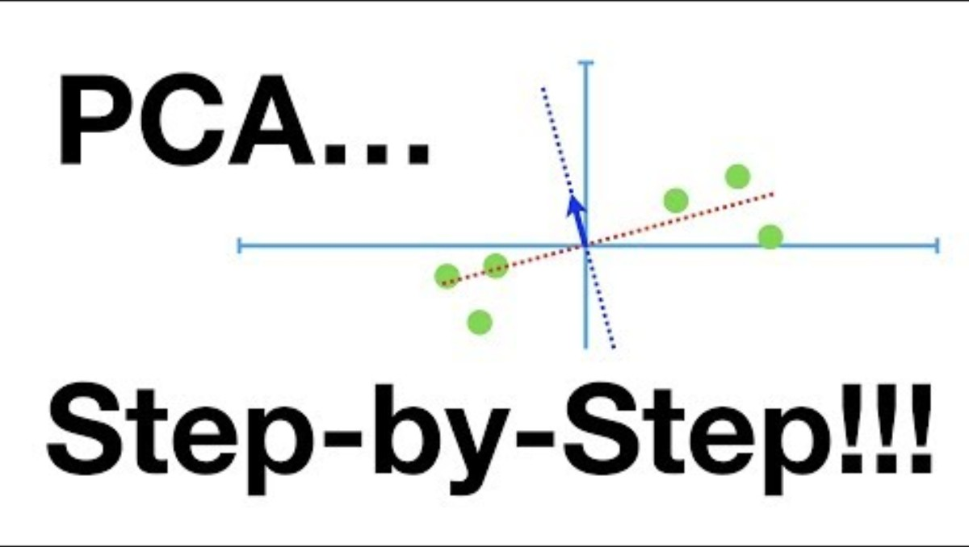
PCA Example

Slide 23
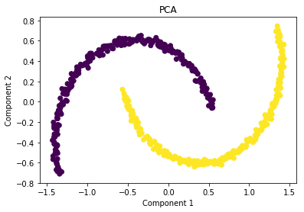
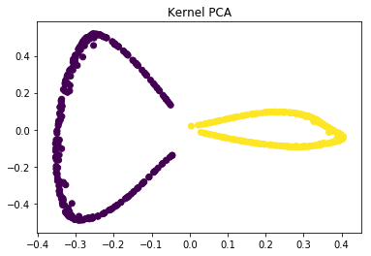
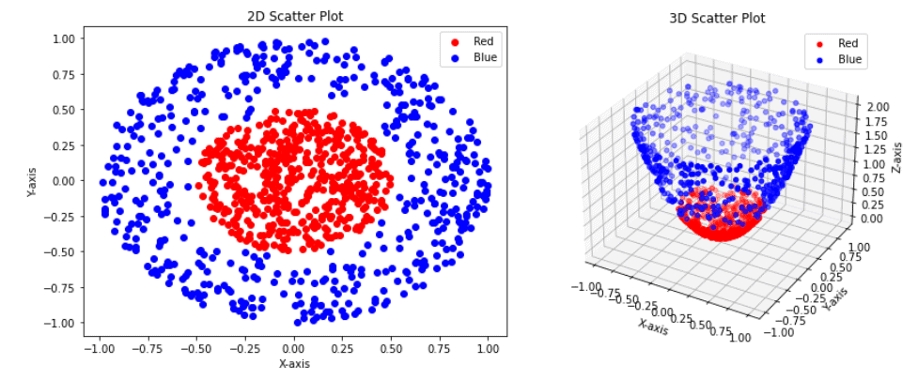
Kernel PCA
PCA is a linear method, which does an excellent work in datasets which are linearly separable.
However, in non-linear datasets, we might get a result which may not be the optimal dimensionality reduction.
Kernel PCA uses a kernel function to project dataset into a higher dimensional feature space, where it is linearly separable, and then applies PCA.
Disadvantage: Can lead to overfitting.

Slide 24
Linear Discriminant Analysis (LDA)

Slide 25
Quadratic Discriminant Analysis (QDA)

Slide 26
Uniform Manifold Approximation and Projection(UMAP)

Slide 27
Dimensionality Reduction Methods Comparison

Slide 28
Imbalanced Classes

Slide 29
Synthetic Data Generation

Slide 30
Smote

Slide 31
Smote-NN

Slide 32
Model Probabilities Calibration

Slide 33
Machine Learning
Data Engineering Notes

